Slide 1
Floor Plan
Bing Li
Frederick Ngo

Slide 2
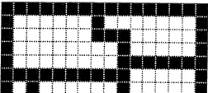
Problem
Given a floor plan, find the area of each room
I = Wall tile
. = Floor tile
IIIIIIIIIIIIIIII
I......I.......I
I......III.....I
I........I.....I
I........IIIIIII
IIIIIIIIII.....I
I.I......I.....I

Slide 3
Solution
Find an unvisited room tile
Call recursive method for tile
Recursive method
Check if the tile has been visited or out of bounds
Yes: return 0
No:
Mark tile as visited
Return 1+sum of recursive call for 4 adjacent tiles

Slide 4
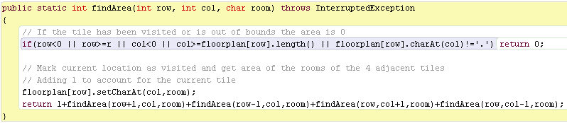
Code

